Slide 1
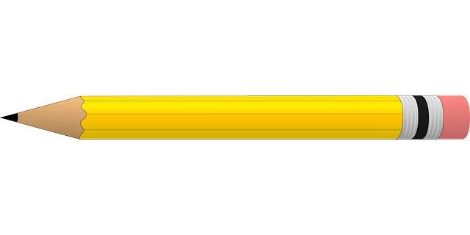
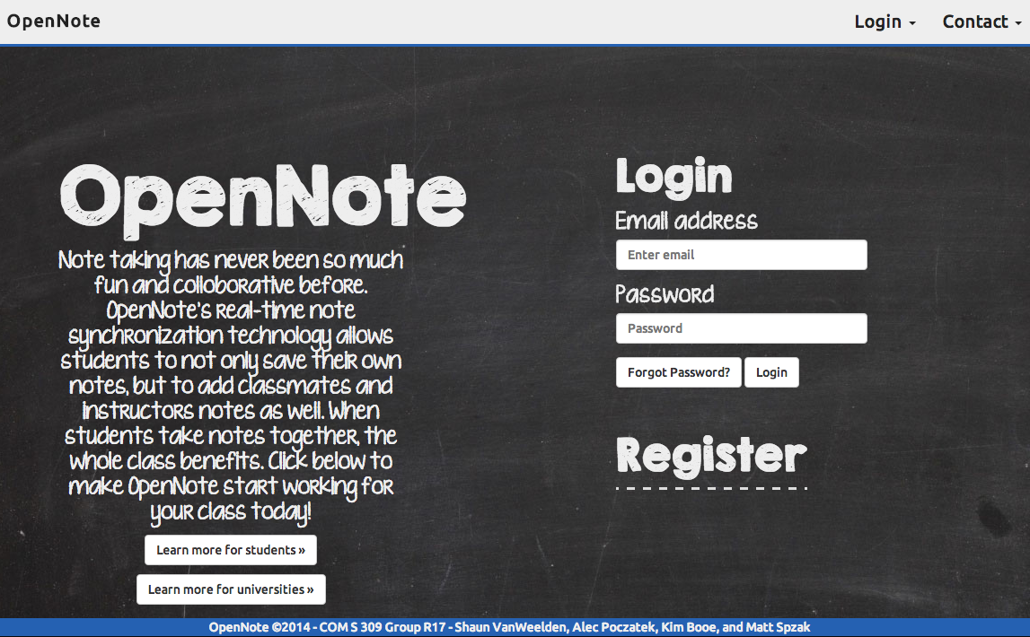
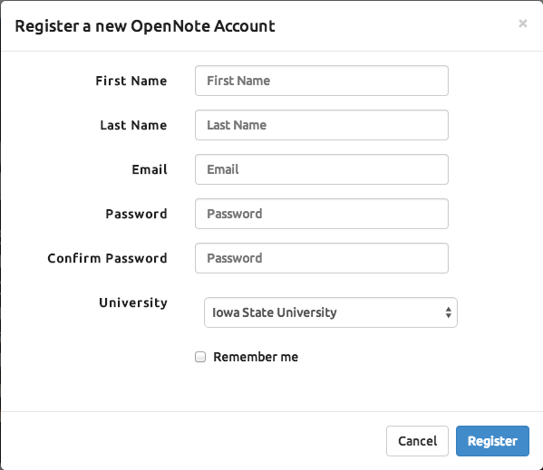
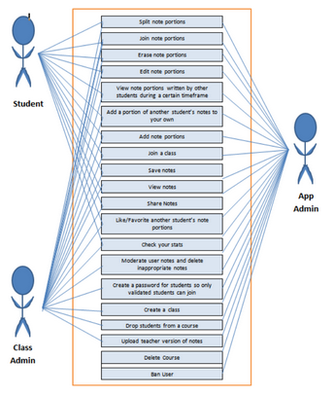
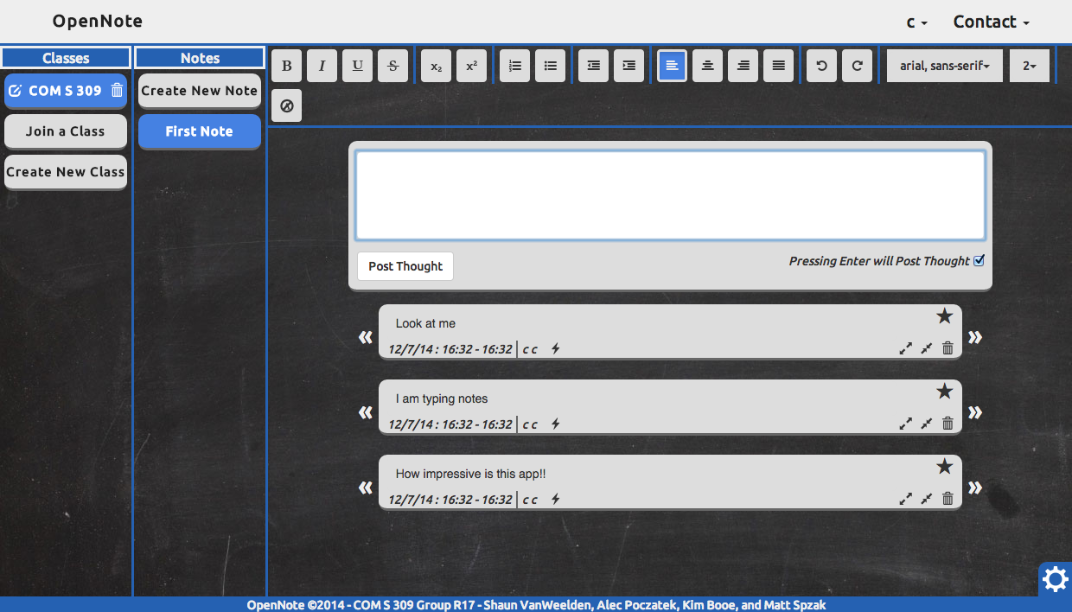
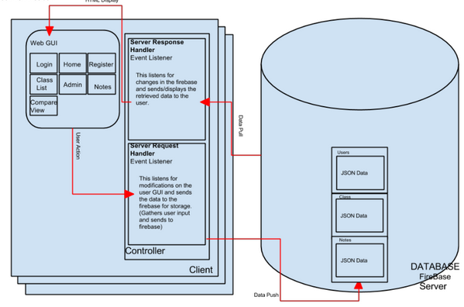
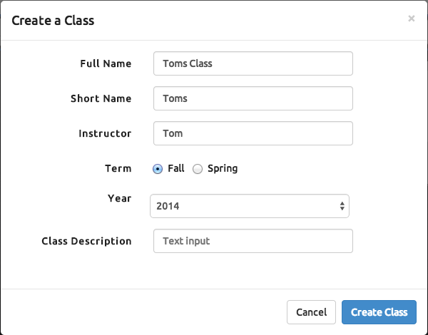
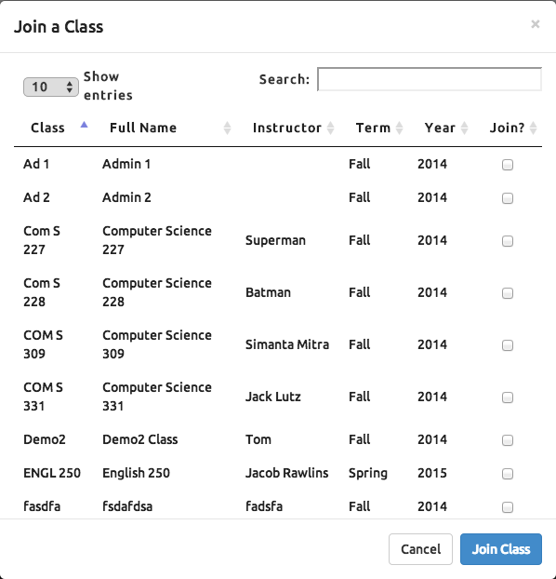
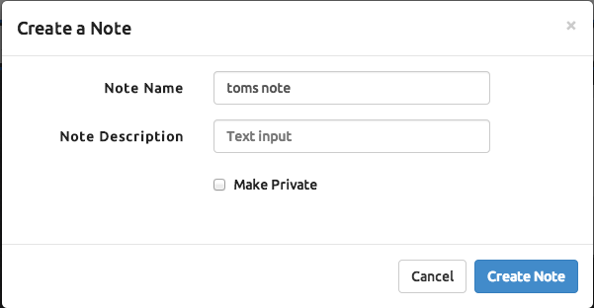
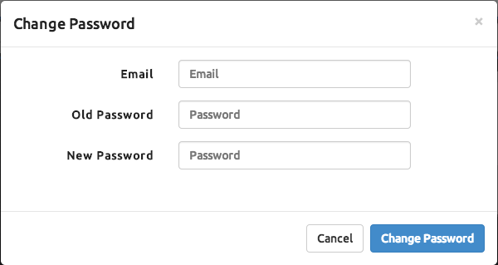
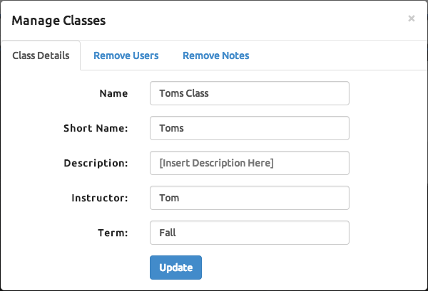
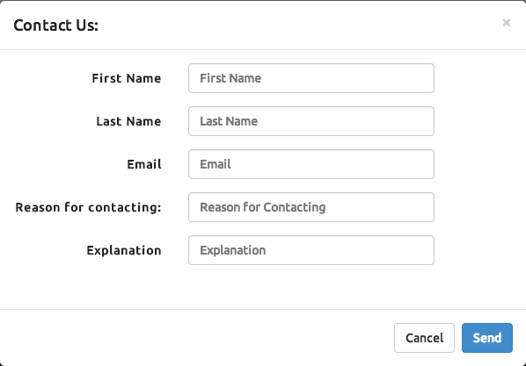
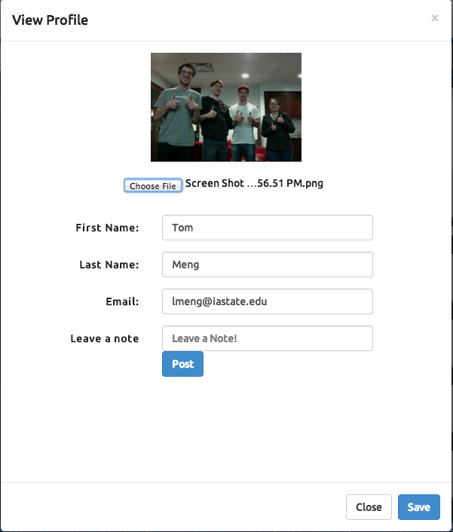
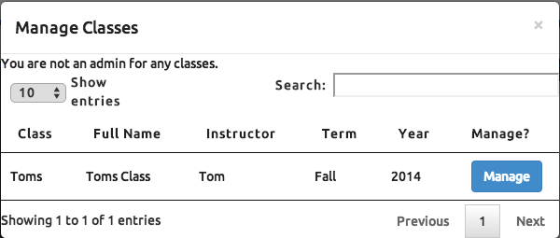
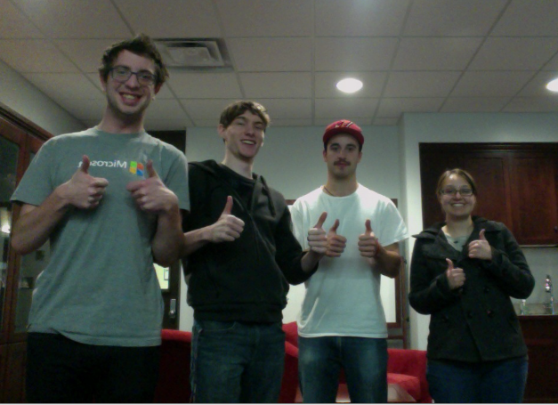
OpenNote
Created By:
Kim Booe
Shaun Van Weelden
Matthew Szpak
Alec Poczatek
COM S 309 Fall 2014
Note taking has never been so much fun and collaborative before. OpenNote’s Real-time synchronization technology allows students to not only save their own notes, but to add classmates and instructors notes as well. When students take notes together the whole class benefits. Below is an image of the login screen. From this screen, you can login, or as a new user, you can register a new account with OpenNote; this modal is also displayed below.
Use-Cases
The app is geared towards the student. The student has the ability to take notes, and share them collaboratively with other classmates. Once a note is created, the student can compare their notes with other classmates in order to fill in a spot they missed, or to insert a better note. The student can also split their notes into different portions, edit their note portions, delete their note portions, or combine their note portions. As a class creator, you have the ability to remove inappropriate users from your class, or to change the information pertaining to the class. The use cases diagram is displayed below.
Login Screen
Registration Modal
User-Interfaces
The user interface for the student and class creator are one in the same. The only difference is that the class creator has more power within the app. They can manage their classes by removing users or changing the class specs/information. Below is the main screen a user would see when using OpenNote. This is the ‘Document Screen.’ From this screen, you can join classes, create classes, create notes, view other students notes, contact OpenNote management, view your profile and change the settings on how you would like to take notes. These are all features available as a student. From the class creator side of things, you can also open your ‘Manage Classes’ modal, in order to add or remove students, as well, you can change the information pertaining to the class.
Different Use-cases
Actors
OpenNote consists of two different types of actors. The above image depicts three actors, however, in the updated version of OpenNote, the app admin role is played by the class creator. The roles are as follows:
Student – Every user that uses the app to take notes is considered a student. They are the users that use the app to keep their notes organized and work together collaboratively with other students to create the best possible notes.
Class Creator – The user that has originally created the class. This user is able to remove users from their class, as well as delete the class they created if they like.
Design Decisions
Above is an image of the login screen. We decided to use a chalk-type font to be cohesive with our note taking theme. It is a very simple user interface, however uses modern transitions from one screen to another. We also decided to use modals to display every pop up window. It is a very modern approach, and rather than switching to a different screen, the window simply has a modal pop up to display the information. Below is a block diagram of how information is processed within firebase, and the users local machine.
Document Screen
From the Document Screen (above) you can access almost all of the features of OpenNote. For example, from this screen, you can contact the management of OpenNote, you can change your password, you can create a new note, create a new class, join a class, you can manage the classes that you are an admin, or you can view your profile. These modals are all displayed below.
Block Diagram
Lessons Learnt
From this project, we have learned a great deal about the process involved in starting from scratch, and working to completion on a web app. We learned that communication is the single most important tool in working effectively. We have seen this in such instances as group members working on the same feature of the app, and then running into merge conflicts. It is also key in finding a solution to a problem you just can’t seem to fix on your own. With group members of all different skill levels, and different backgrounds it is key to understand each members strengths and work accordingly. The biggest thing we learnt is that you will not succeed if you don’t try. We created our app using firebase. No one in our group was familiar with firebase when we started, but with practice we all learned a great deal and it is a great tool that can be used.
Create a Class Modal
Join a Class Modal
Create a Note Modal
Other Features
OpenNote has other features that have not been mentioned. As a OpenNote user, you have the ability to synchronously compare your notes with other users in your class from similar time frames. While taking notes, if you have two notes that are related, you can join them together into one thought, or do the latter, and split a thought into two thoughts. Another feature is the flashcard feature, in which the user can flip the thought over, write a keyword and use this effect for studying. A final feature is the star feature in which the user can star an important note, and at the end of the session, they can print a study guide, consisting of all of the starred elements on one page to make it easy for studying the key points.
Change Password Modal
Manage Classes Modal - 2
Contact Modal
Team Info
Coming into this project, none of our group members knew too much about each other. But having spent a whole semester together we have learned a lot, and grown to become very good friends. We learned a great deal about the process involved in making an app, as well as how important communication is. It isn’t always opportune to meet for everyone so it is extremely important to split up work and collaborate often.
Manage Classes Modal - 1
Personal Profile Modal
Team R17 – Raising the Bar

